Slide 1
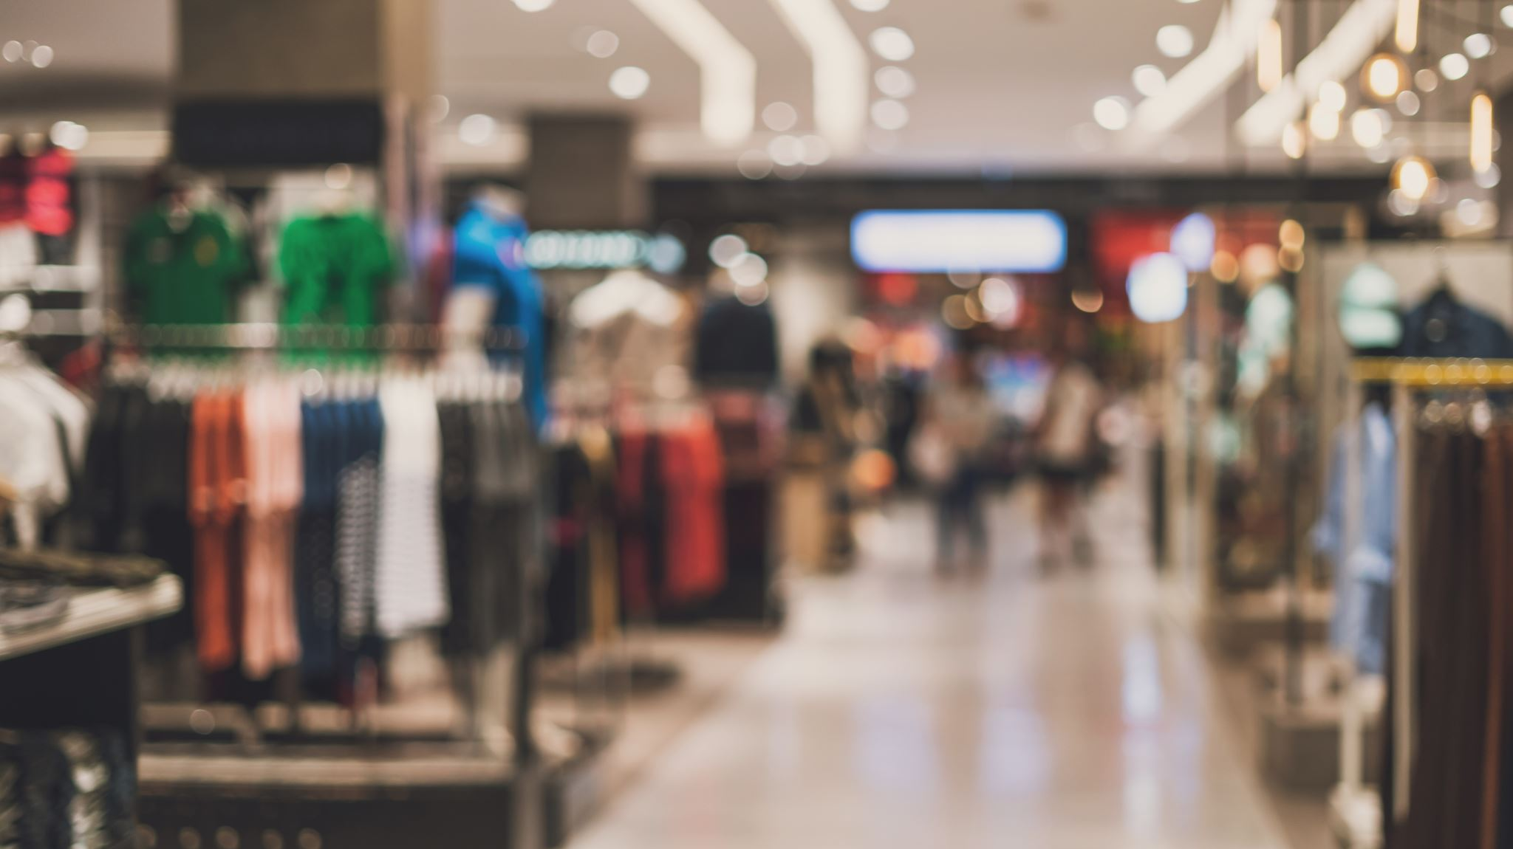
Ultimate Shopping Experience
Adam Nixon, Zachary Burgess

Slide 2

The Solved Problem
The problem we aimed to solve was the hassle of buying products online
As you will see, we solved this problem by creating a simple, yet beautiful, user-friendly application to handle all purchasing needs

Slide 3

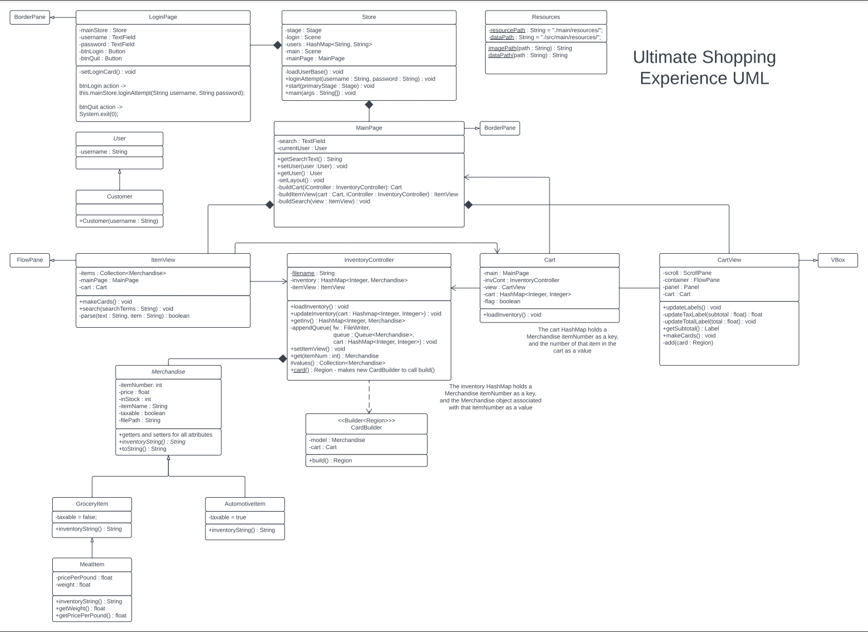
UML

Slide 4

Design
The app has two main scenes:
Login Page
Main Store
The Main Store has two main views:
Inventory View
Cart View
The main actions to be taken are
Add item to Cart
Remove Item From Cart
Clear items from cart
Purchase cart

Slide 5

Data Structures
HashMap<Integer, Integer>: Keeps track of items in the cart
HashMap<String, String>: Stores the user base for logging in
Collection<Merchandise>: Collection of purchasable items
HashMap<Integer, Merchandise>: Stores and controls inventory

Slide 6
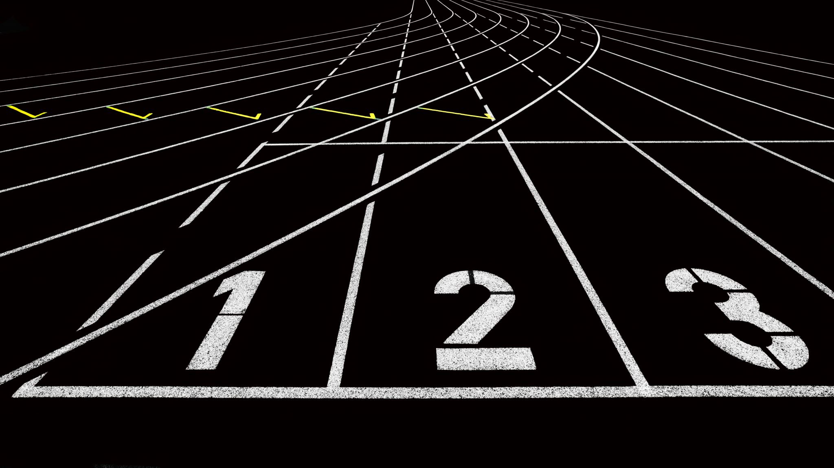
Challenges
- Formatting for the csv files was a hassle – a database would allow for a smoother implementation without the need of a switch
- Setting pane backgrounds in the Main Store

Slide 7

Future Additions
Addition of wish-lists so users can store their cart for later
Ability to signup so the creation of new users is possible
Addition of more items and item types
Database implementation

Slide 8

Live Demo

